Slide 1

Protecting Yourself from Phishing Attacks
In the present digital climate, threats keep evolving. Phishing attacks continue to be among the major online scams, where you are tricked into revealing some sensitive information. This presentation will give you the knowledge and tools to recognize, prevent, and report these diabolical threats to protect your private and financial information.
PRESENTED BY
AJAY E

Slide 2



Introduction
Understanding Phishing: The Digital Lure
Phishing is a subset of cybercrime aimed at tricking someone into revealing sensitive information, such as usernames, passwords, or credit card information, by impersonating a trustworthy entity. They normally come in the form of fake emails, text messages, or bogus websites. The defense starts by recognizing the marks.
Deceptive Emails
Fake Websites
Smishing & Vishing
Emails designed to look legitimate, often from banks, social media, or service providers.
Websites meticulously crafted to mimic official sites, complete with logos and branding.
Phishing attempts conducted via SMS (smishing) or voice calls (vishing).

Slide 3
Recognising the Threat
Spotting Phishing Emails and Fake Websites
Attackers use various subtle clues to make their phishing attempts appear legitimate. Learning to identify these red flags is crucial for protecting yourself.
Email Red Flags
Website Red Flags
Suspicious Sender: Mismatched sender address or generic email domains.
Incorrect URL: Subtle misspellings or extra characters in the web address.
Generic Greetings: "Dear Customer" instead of your name.
No HTTPS: Lack of a padlock icon or "https://" in the URL bar.
Urgent/Threatening Language: Demands for immediate action or threats of account closure.
Poor Design/Low Resolution: Pixelated logos or inconsistent branding.
Poor Grammar/Spelling: Unprofessional language or numerous errors.
Requesting Excessive Information: Asking for data not typically required.
Unusual Links/Attachments: Hover over links to check the URL before clicking.
Pop-up Login Forms: Unexpected or suspicious login prompts.

Slide 4

Case Study
Real-World Example: PayPal Phishing Scam
Let's examine a common phishing scenario to understand how attackers operate and what to look out for.
The Attack
Suppose you would receive an email supposedly from PayPal, stating that your account has been "limited due to unusual activity." There will be a link in the e-mail telling you to "verify your account details immediately" to prevent permanent suspension.
By clicking on it, you will be taken to a phishing clone of the PayPal login page with the logo and design there. Entering your credentials will immediately send them to the attacker.
Always verify such claims directly through official channels, never by clicking links in suspicious emails.

Slide 5



Psychological Manipulation
Social Engineering: The Human Element of Phishing
Attackers often exploit human psychology to bypass security measures. This is known as social engineering, where they manipulate you into taking specific actions or divulging information.
Urgency & Fear
Greed & Curiosity
Authority & Trust
Creating a sense of immediate danger or consequence if you don't act quickly.
Promising rewards, prizes, or exclusive content to entice clicks.
Impersonating trusted figures like IT support, bank officials, or government agencies.
These tactics bypass logical thinking, making it essential to remain vigilant and question unexpected requests.

Slide 6
Best Practices
Your Defence Toolkit: Tips to Avoid Falling Victim
Empower yourself with these essential best practices to significantly reduce your risk of becoming a phishing victim.
1
Verify Sender
Always double-check the sender's email address and domain. Look for exact matches, not just similar ones.
2
Hover & Inspect
Before clicking, hover your mouse over any links to preview the actual URL. If it looks suspicious, don't click.
3
Use Strong Passwords
Create unique, complex passwords for each account and consider using a password manager.
4
Enable 2FA
Activate two-factor authentication (2FA) wherever possible for an added layer of security.
5
Be Skeptical
If an offer seems too good to be true or a request feels urgent, it probably is. Always verify independently.

Slide 7
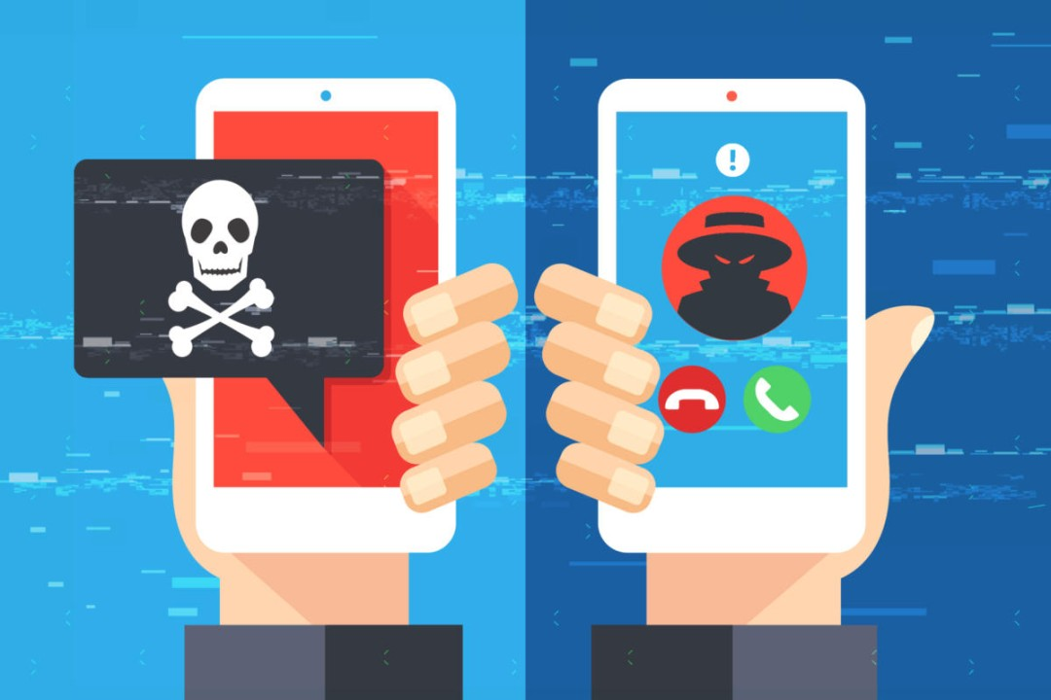
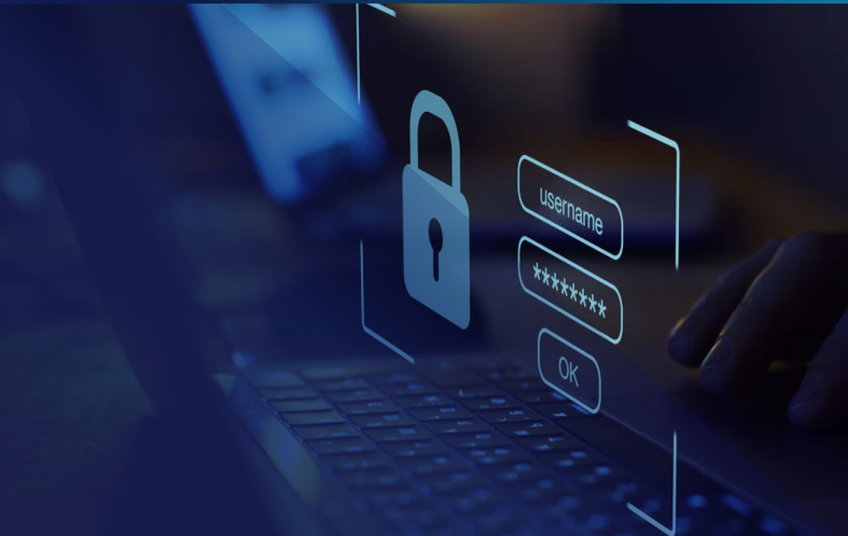
Advanced Techniques
Beyond the Inbox: Protecting Against Evolving Threats
Phishing isn't just about emails anymore. Attackers are increasingly using other channels and sophisticated techniques.
Smishing & Vishing
Website Security
Be wary of suspicious text messages (smishing) or phone calls (vishing) asking for personal information or directing you to fraudulent websites. Always verify the caller's identity through official channels before sharing any data.
Always ensure websites use HTTPS (indicated by a padlock icon) for secure connections. Be cautious of pop-up windows asking for login credentials, especially if they appear unexpectedly or outside of a legitimate login process.

Slide 8

Quiz Time
Test Your Phishing Detection Skills
Put your newfound knowledge to the test! Can you identify the phishing attempt?
Scenario:
You receive an email from "Apple Support" (support@appple.com) stating your Apple ID has been locked due to suspicious activity. It asks you to click a link to "unlock your account immediately" to prevent permanent deletion.
Is this a phishing email?
Why?
A) Yes, definitely.
The correct answer is A) Yes, definitely. The most obvious red flag is the sender's email address: "appple.com" has a subtle misspelling. Additionally, the urgent and threatening language ("locked," "immediate," "permanent deletion") is a common social engineering tactic used by phishers. Always check the sender's domain carefully!
B) No, it looks legitimate.
C) Maybe, I need more information.

Slide 9
What to Do
Reporting Phishing Attempts
If you encounter a phishing attempt, reporting it is crucial. Your actions help protect others and contribute to a safer online environment.
Report It
Do Not Engage
Forward the suspicious email to the Anti-Phishing Working Group (APWG) at reportphishing@apwg.org. Most email providers also have a "Report Phishing" option.
Do not reply to the email or click on any links. Do not open any attachments.
Inform Others
Delete It
If the phishing attempt targets your workplace or community, inform relevant IT security teams or administrators.
After reporting, delete the email from your inbox to prevent accidental interaction in the future.

Slide 10

Stay Safe Online!
Phishing threats are persistent, but with vigilance and awareness, you can protect yourself and your digital life. Remember these key takeaways:
Be Suspicious:
Always question unexpected emails, messages, or calls, especially if they demand urgent action or personal information.
Verify Everything:
Double-check sender details, hover over links, and confirm requests through official channels.
Secure Your Accounts:
Use strong, unique passwords and enable two-factor authentication.
Report & Delete:
Help fight cybercrime by reporting phishing attempts and deleting them.
Your awareness is your strongest defence. Thank you for your attention.

Slide 11


